Slide 1

SC1015 mini proj:
Predicting video game sales
Lab group: DSF1 , Group 5
Members: Derrick Ng
Dexter Voon

Slide 2
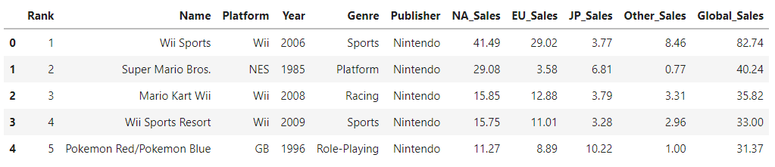
Data introduction
•Dataset from kaggle: “Sales of Video Games” by ARSLAN ALI

Slide 3
Motivation & goals
•Video games are becoming increasingly popular.
•What factors affect how popular a game is?
•Can we predict how popular a game will be?
Goal
To predict how popular a game is based on its attributes.

Slide 4
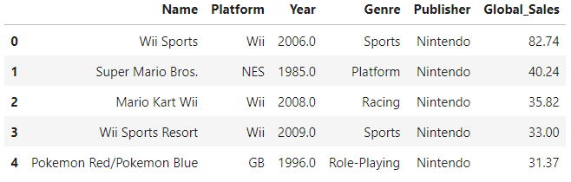
Data cleaning & EDA
Dropped rank, and NA, EU, JP and other sales

Slide 5
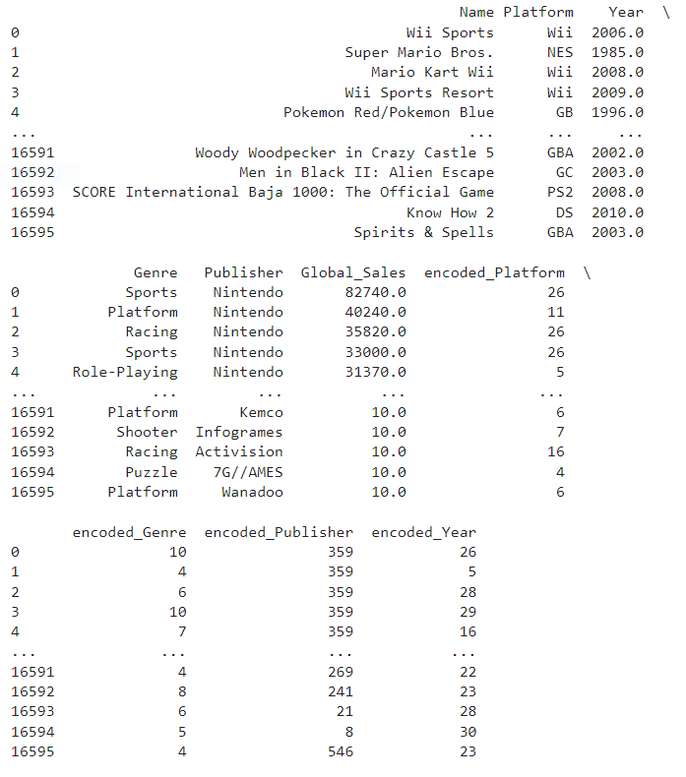
Data cleaning & EDA
•Encode categorical data into numerical
•Convert Global_Sales millions -> thousands

Slide 6
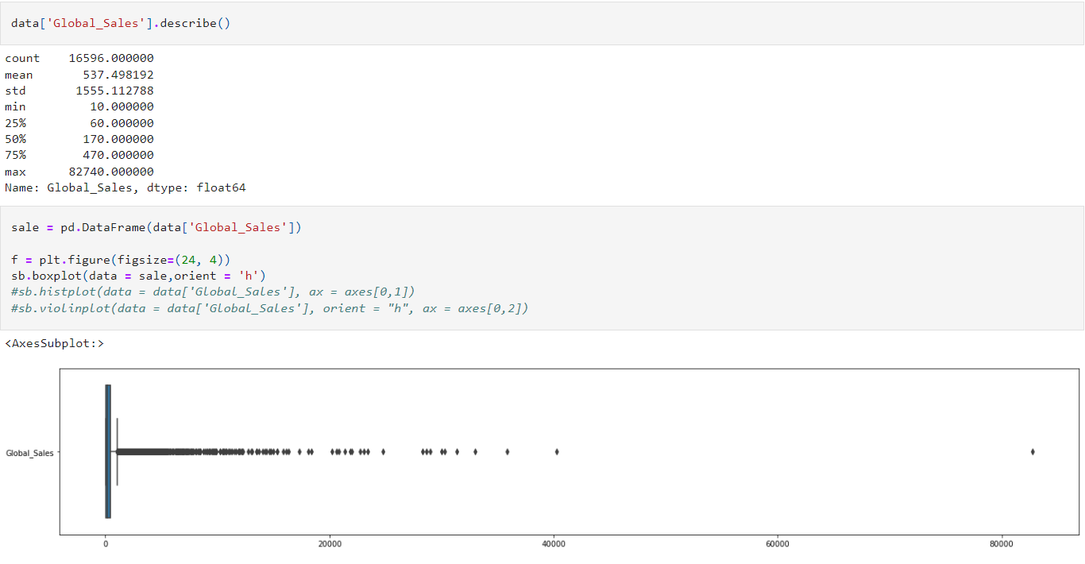
Data cleaning & EDA
•Exploring Global_Sales

Slide 7
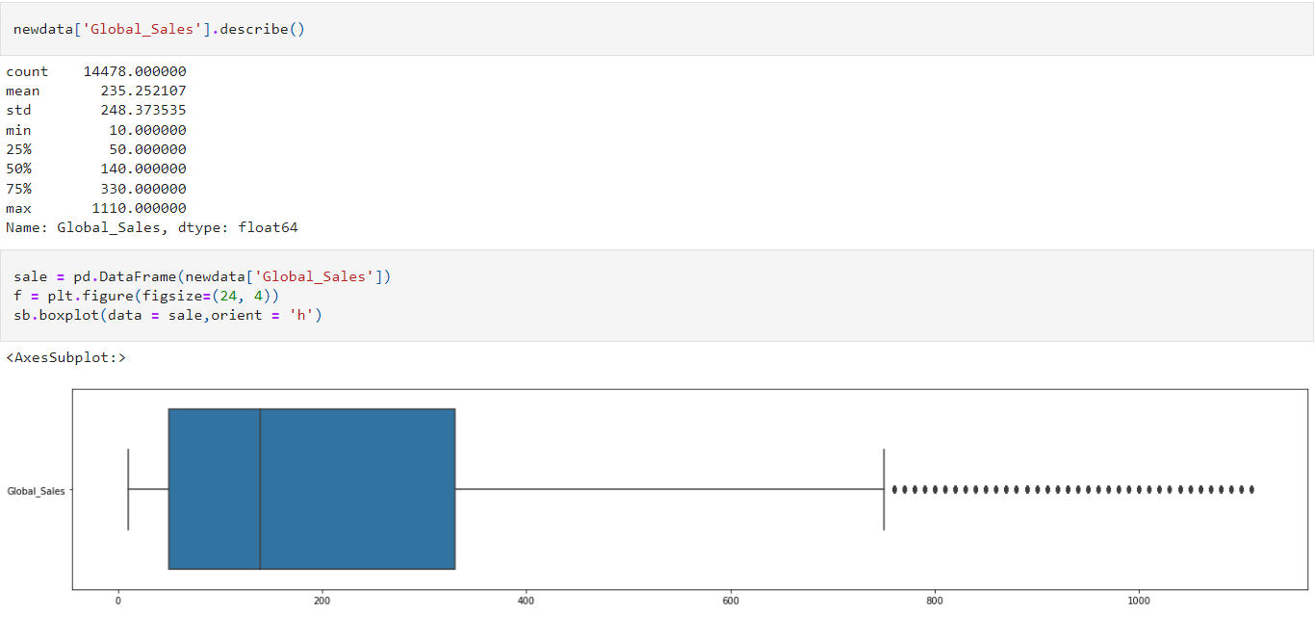
Data cleaning & EDA
•Cleaned outliers

Slide 8
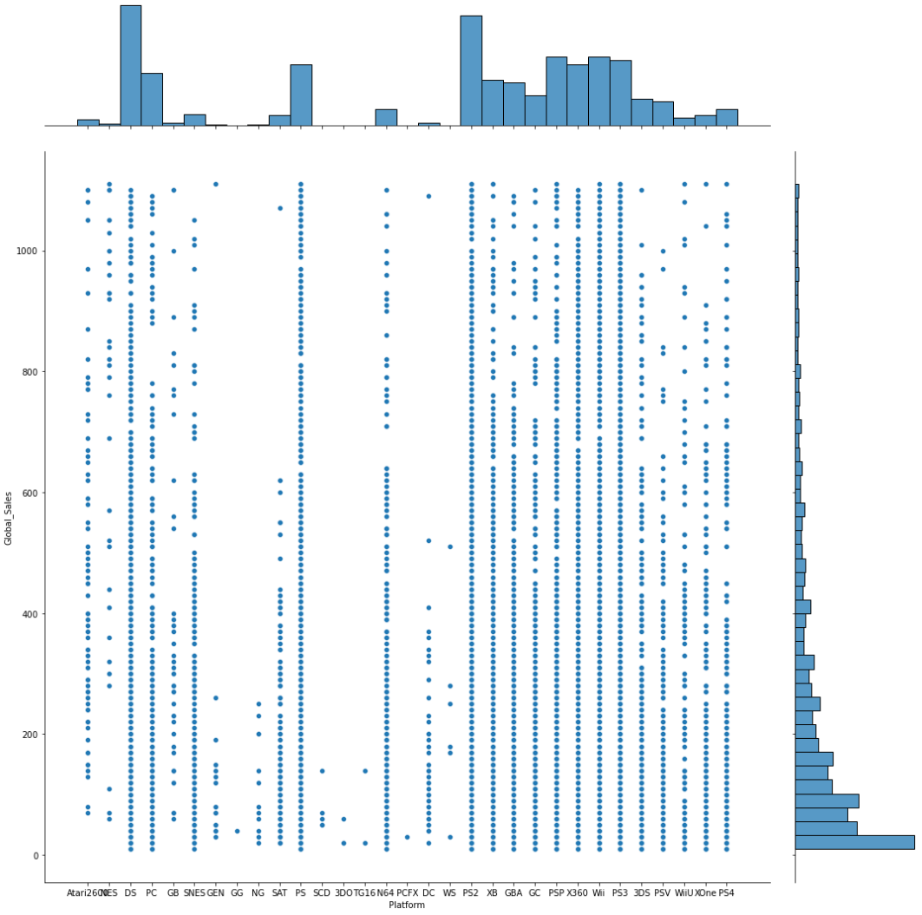
Data cleaning & EDA
Platform & Sales
• Well known platforms such as DS, PS, XBOX 360 do fairly well
• Lesser known platforms such as GG, SCD, PCFX do not have as much sales

Slide 9
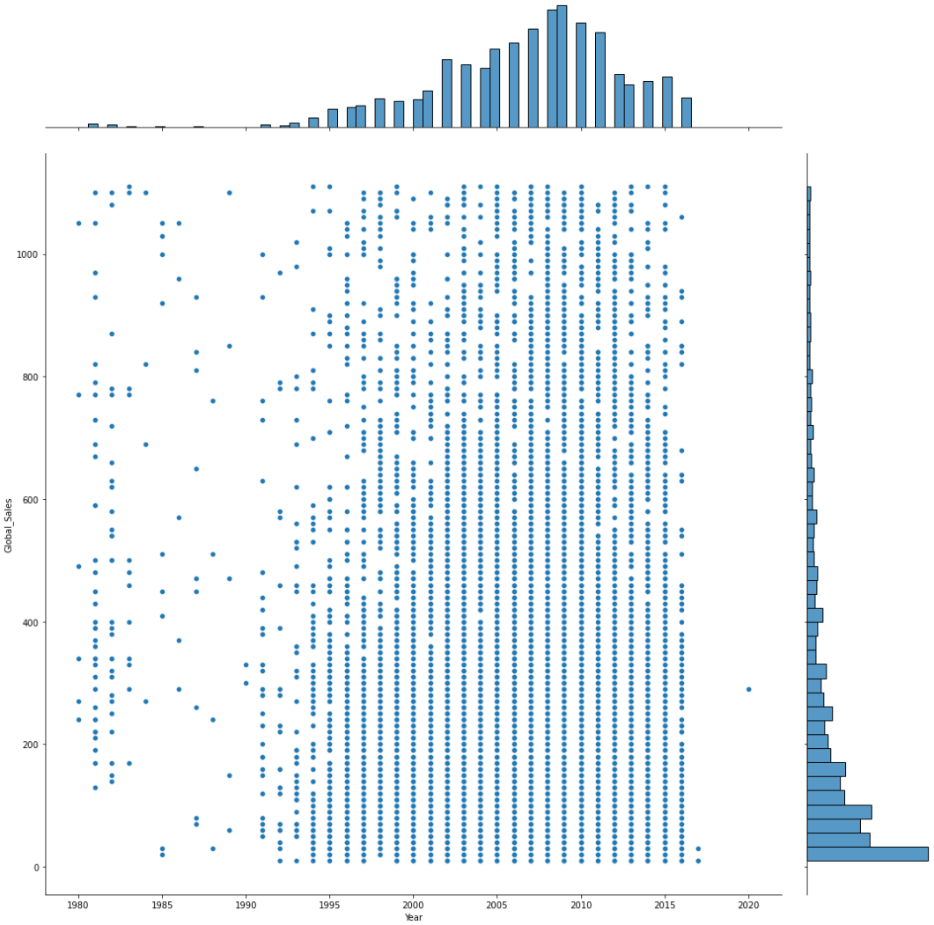
Data cleaning & EDA
Year & Sales
• Before 1995, there were not as many video games, and each game had varying sales
• From around 1995 to 2016 there were more games and increased sales

Slide 10
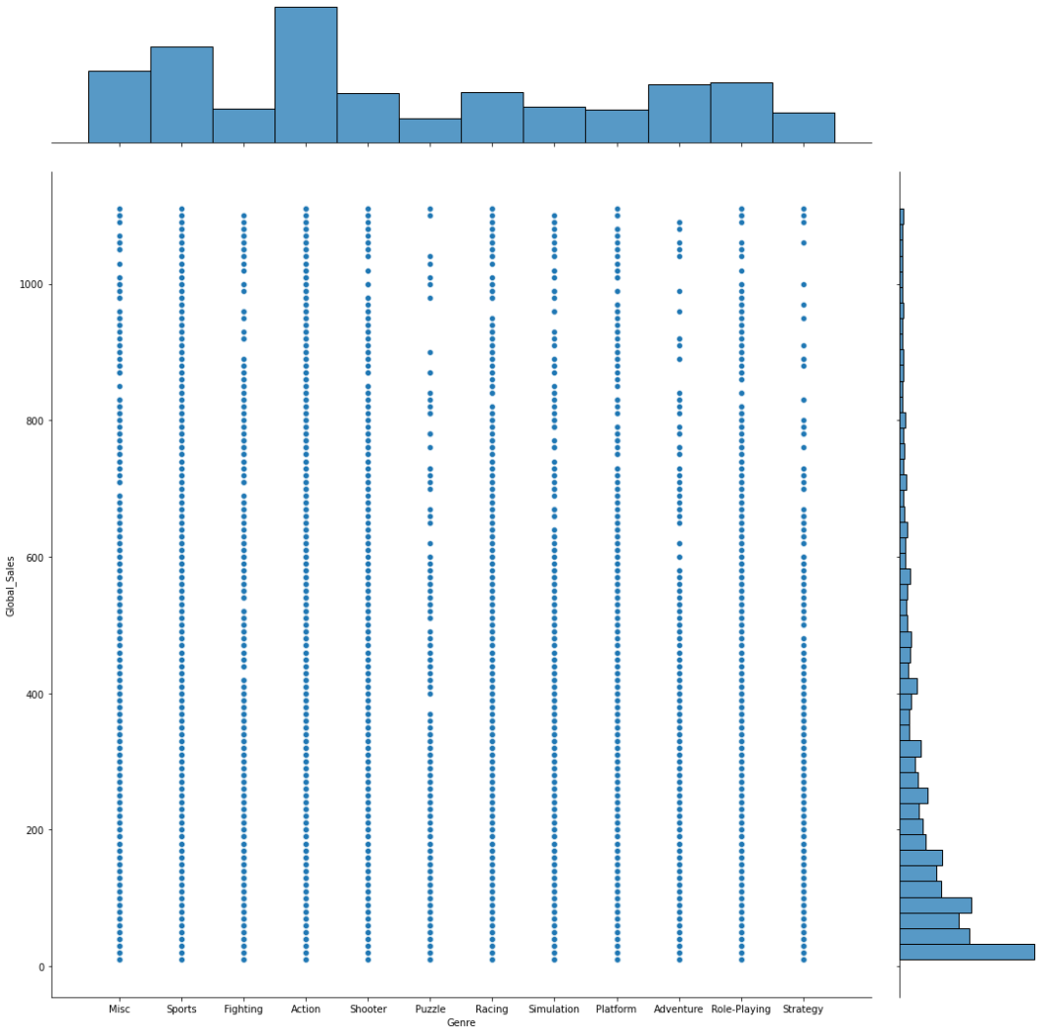
Data cleaning & EDA
Genre & Sales
• Genres such as action and sports have more games
• But within those genres, they have varying sales as well

Slide 11
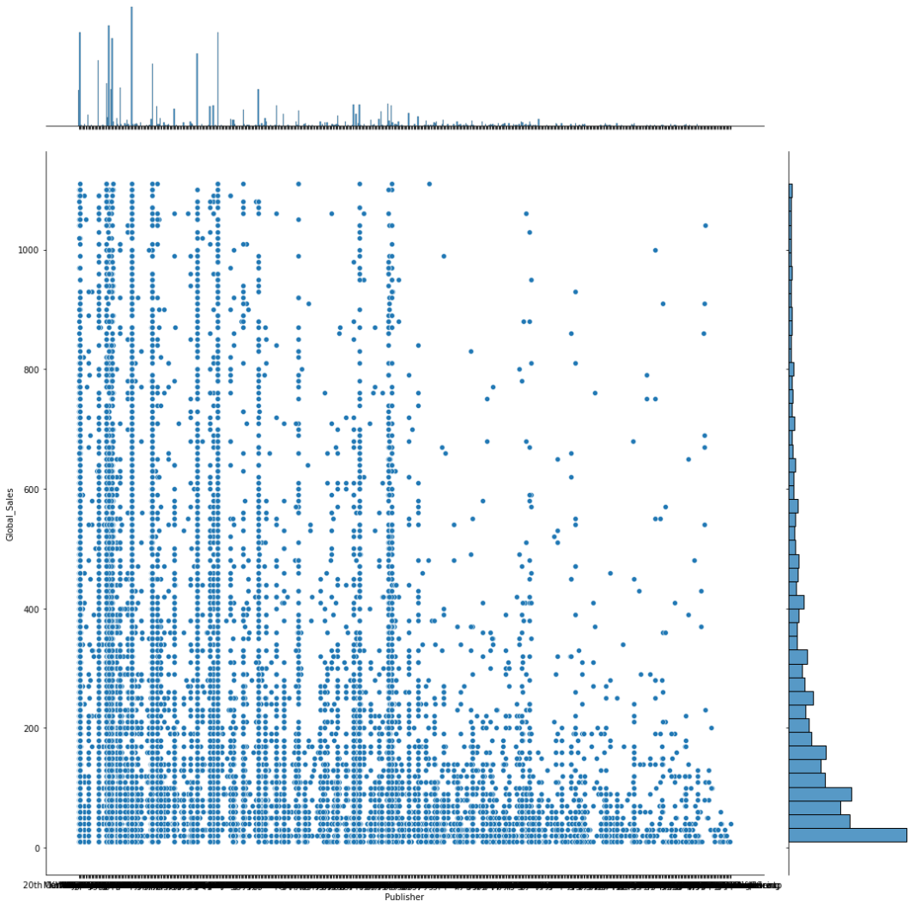
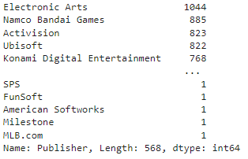
Data cleaning & EDA
Publisher & Sales
• Around 500+ publishers
• Some publishers have significant differences in the number of games.
•Publishers with less games have generally less sales for each game

Slide 12
Data cleaning & EDA
•For Platform and Publisher, we can tell that there is a trend whereby specific platforms and publishers have more sales.
•For Year and Genre, there is no significant link to sales
•Explore the link between attributes

Slide 13
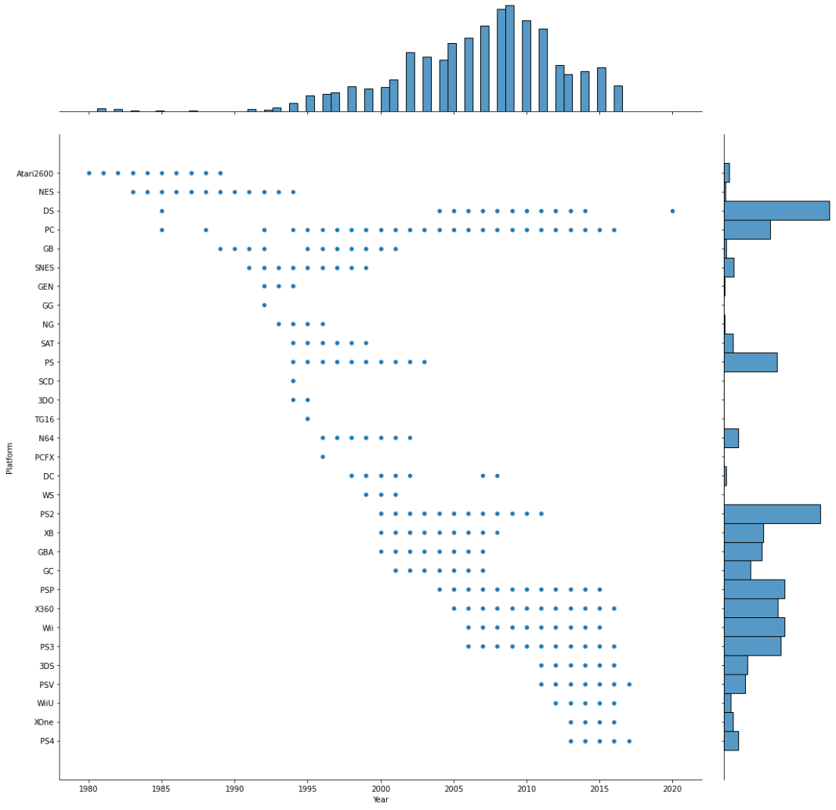
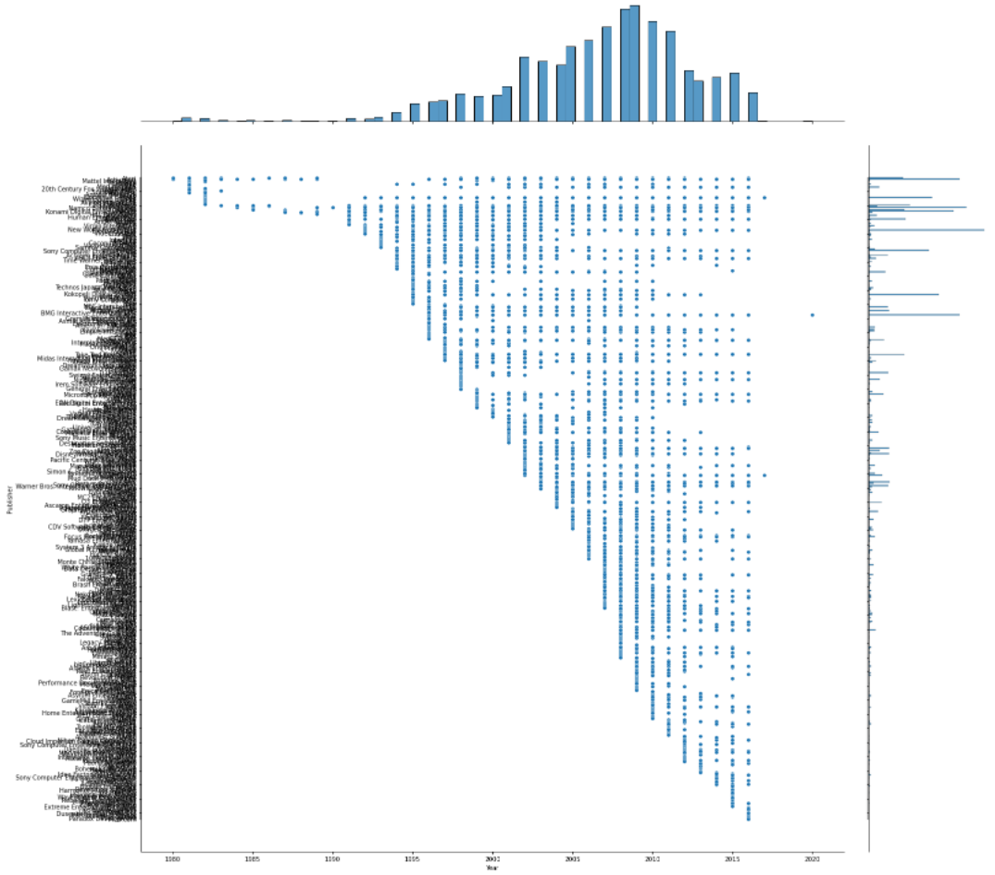
Data cleaning & EDA
Notes:
As the years increase, we can see a trend in publishers and platforms.
On the left, some platforms supported games only for a period of time. Atari 2600 and NES supported games earlier in the years and stopped in recent years. PSV and PS4 started supporting games only much later. Platforms such as PC have been supporting games consistently throughout the different years.
On the right, Some publishers have been publishing games consistently throughout the years while some started publishing games recently.

Slide 14
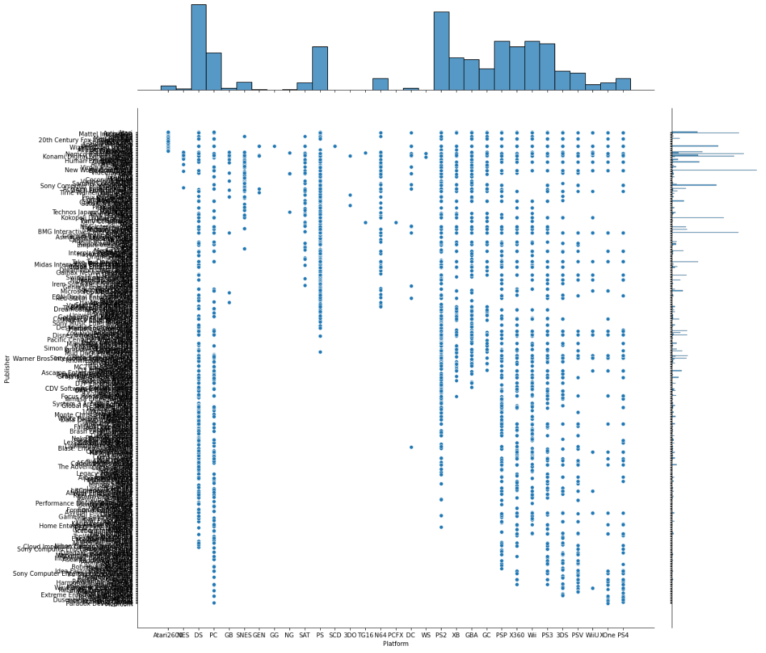
Data cleaning & EDA
Platform & Publisher
•Some platforms only support games by a few publishers
•Some platforms support games by most publishers
•Some publishers have games supported by most platforms
•Some publishers have games supported by limited platforms

Slide 15
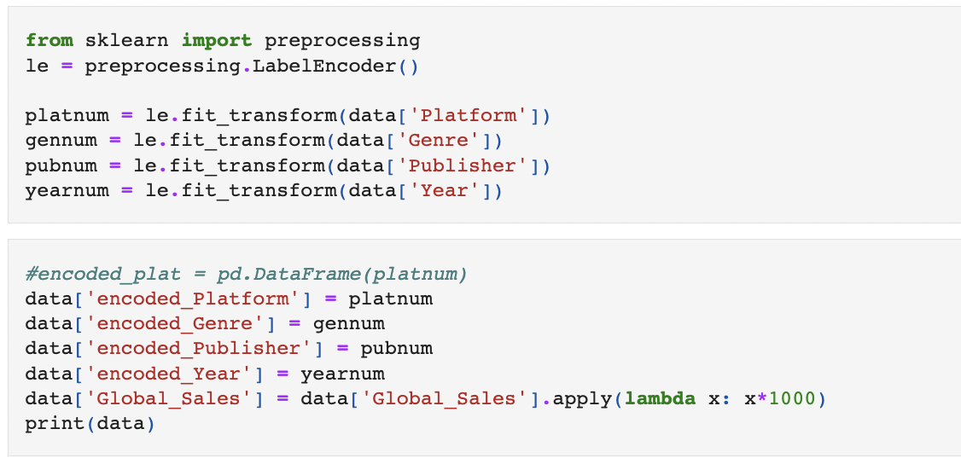
Machine Learning Models
Details of Game: Publisher, Genre, Platform, Year
Notes:
For the next segment, I will be explaining more about the machine learning models that we will be using for our video game data set.
Firstly, to predict our Global sales, we will require some data regarding the details of the game. These details from our dataset are Platform,Genre,Publisher and Year..Before proceeding to create our model, we would need to encode our categorical data into encoded data with numeric values.

Slide 16
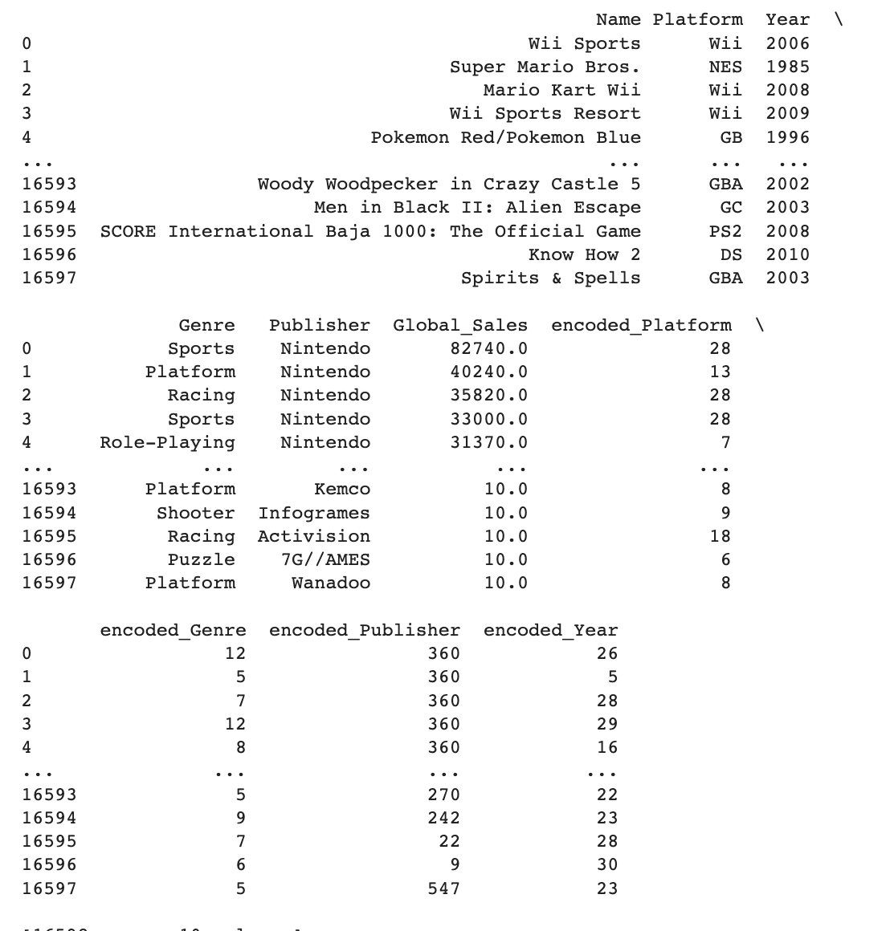
Encoded Genre,Platform,Publisher,Year
Notes:
With these encoded data, we would be able to construct our machine learning model by splitting their data into train and test sets

Slide 17
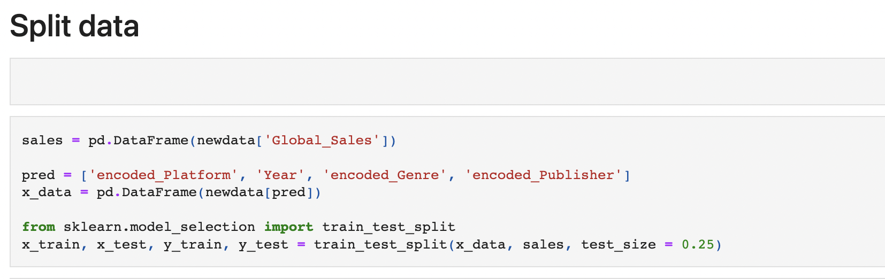
Machine Learning Models
Notes:
For the next segment, I will be explaining more about the machine learning models that we will be using for our video game data set.
In this scenario, we will be importing train_test_split from sklearn with test_size of 0.25, which is a quarter of our data in the test data set while 3quarter of it in our train data set.

Slide 18
Machine Learning Models
Linear Regression
Gradient Boosting Regression
Random Forest
Notes:
For our machine learning models, we will be using 3 different models. Namely, Linear regression, , gradient boosting regression and then followed by the random forest. With these 3 models, we will be comparing their Explained variance , to analyse which is a better fit to our machine learning model.

Slide 19
Gradient Boosting Regressor
Random State - random seed given to each Tree estimator at each boosting iteration.
n_estimators - The number of boosting stages to perform
Notes:
For our parameter for the gradientBoosting regressor, we will be using its default values, except the random state. The random state allows us to control the random seed given to each Tree estimator at each boosting iteration.
One parameter that we kept it at default is the n_estimators of the regressor : n_estimators refers to The number of boosting stages to perform. As Gradient boosting is fairly robust to overfitting, a large number usually better and results in better performance.
However, we kept the n_estimators as default is so that we can compare the gradient boosting model to another model such as random forest to make a fair comparison of both models. Though, the n_estimators of both random forest and gradient boosting regressor are referring to different objects, we have to ensure a fair distinction between our models and to understand which machine learning model actually works better for our video game data set, and not because of their n_estimators that makes the model better.

Slide 20
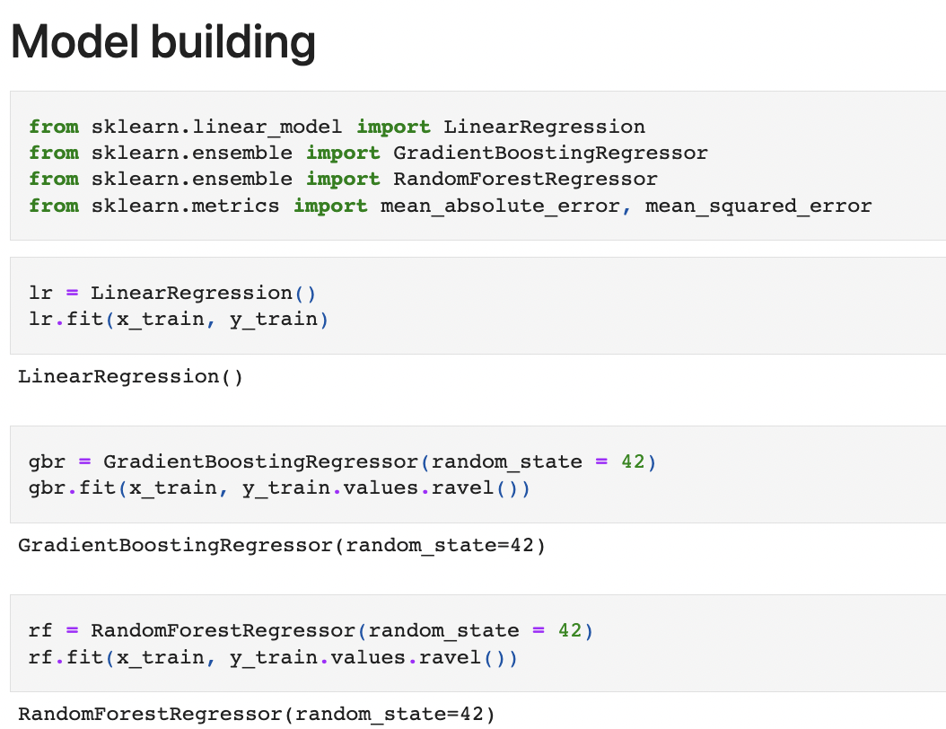
Model Building and Fitting
Notes:
As you can see from our code, we implemented 3 different models, and we fit them into our X_train and Y_train. Our X_train will consist of data from encoded_platform,encoded_genre,encoded_publisher and year. Whereas our y train will consist of data from our Global Sales.

Slide 21
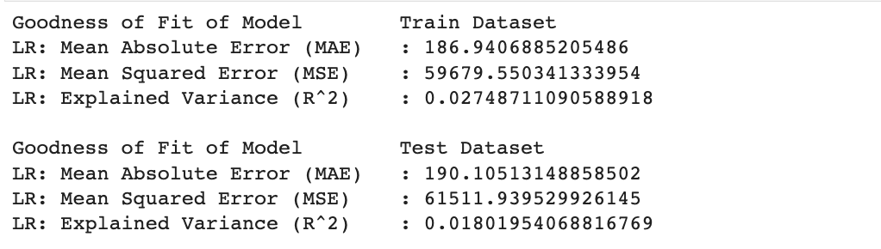
Linear Regression
Notes:
firstly, we will analyse the explained variance of our linear regression model. As you can see from our code, our explained variance of the train data is about 0.0275 and our test data is 0.0180. We can see that our linear model’s rsqaured value is close to zero, this shows that the linear model is not really a good fit to our machine learning model.
Take note the rsqaured values ranges from 0 to 1 and 1 being the best goodness of fit to our model.
Also, take note that if you were to run the code we posted in git hub, you would not obtain the same output a as this is due to the train_test_split that we have used which splits arrays or matrices into random train and test subsets ,

Slide 22
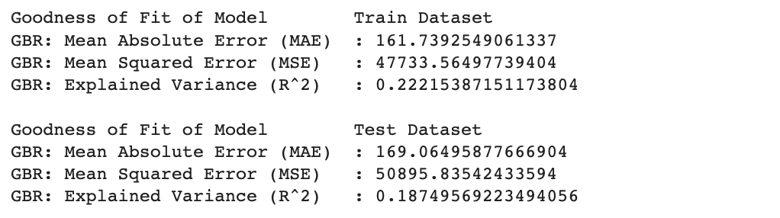
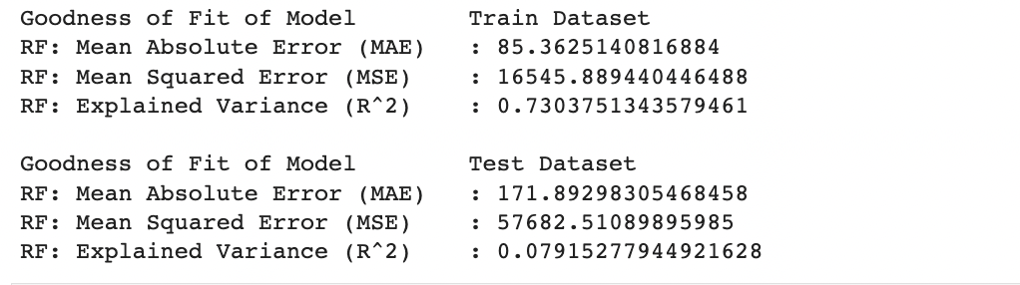
Linear Regression:
Gradient Boosting:
Random Forest:
Notes:
next, we can see that out explained variance of our gradient boosting regression model is slightly better than our linear model. The explained variance of our gradient boosting regressor train data has improved from 0.02 to 0.2. whereas the test data has also improved from 0.018 to 0.18.
lastly, we examine our random forest model. we can see that our r squared value of our train data has improved significantly from 0.2 to 0.7 which is much closer to 1! However, our explained variance for our test data set has decreased.
overall,we can see that our random forest and gradient boosting model shows a better goodness of fit as compared to our linear model. Our machine learning model has improved!

Slide 23
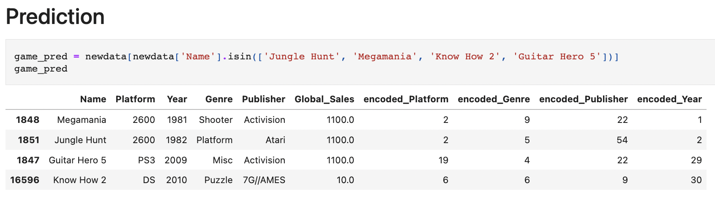
Prediction
Notes:
For our prediction, we will be using a few games to test our models. We will use games such as Megamania, Jungle Hunt, Guitar Hero 5 and Know How 2.

Slide 24
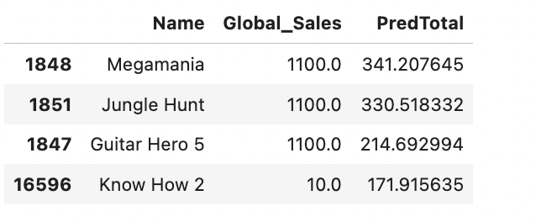
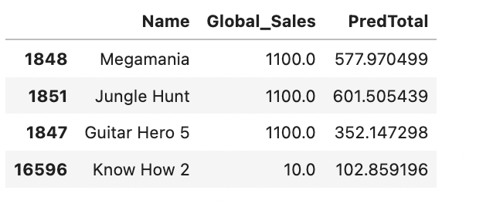
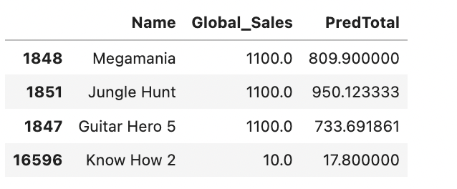
Linear Regression:
Gradient Boosting:
Random Forest:
Notes:
following up, we will use our models to predict global sales for our video games. We will use all 3 models and compare their prediction to their actual global sales values.
As you can see, our prediction gradually improves and gets closer to the actual global sales. from our table our gradient boosting and random forest regressor actually has the closer prediction to the actual value of Global sales as compared to the linear regression

Slide 25
Problem of Overfitting
Gradient Boosting Regression
overemphasis of outliers
Notes:
Lastly to end off, we may have achieved our outcome of finding the better fit to our machine learning model for our video game data set to predicting the global sales of a game , however there are also some disadvantages to using these models for our video games - Global SAles prediction.
For example, as Gradient Boosting Models builds an additive model in a forward stage-wise fashion where it allows for the optimization of arbitrary differentiable loss functions, In each stage a regression tree is fit on the negative gradient of the given loss function. This means that our model will continue improving to minimise all errors. This can overemphasise outliers and cause overfitting in our model. Therefore, in order to reduce this problem of overfitting, we have decided to clean our data and dropped outliers in our data based on our Global sales boxplot before proceeding to fitting it to the gradient boosting model.

Slide 26
Complexity of Problem
Random Forest
creating large number of trees
reduce run-time performance as complexity increases
Notes:
Also ,while random forests model may perform better as compared to the other 2 models. The random forest model may not work as effectively as compared to the gradient boosting model if the problem of predicting global sales of video games becomes more complex and sophisticated. As the complexity of the problem increase, the model has to create a large number of trees which make the algorithm slow and ineffective for real-time predictions, hence compromising run-time performance.

Slide 27
Conclusion
Notes:
Therefore, in conclusion , while random forest and gradient boosting is a good fit to our machine learning model, which shows better performance than our linear model, we have to also consider other factors such as the complexity of the problem and dimensionality of the data. All in all ,There’s no single model that works in every situation, when we consider the other constraints of real-life systems, our problem become complex and we have to ultimately weigh which models best fits accordingly to our objective and motivation of our problem.
That is all for our group presentation thank you.

Slide 28
Thank you

Slide 29
References
•Clement, J. (2021, November 23). Global video game market value from 2020 to 2025 (in billion U.S. dollars). statista. Retrieved April 22, 2022, from https://www.statista.com/statistics/292056/video-game-market-value-worldwide/

